Slide 1
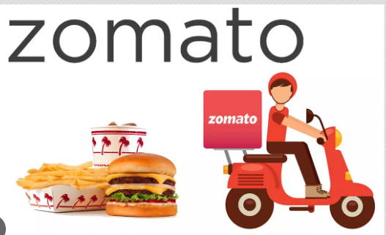


Spreadsheet: Zomato Restaurants Expansion
NAME-> ANKIT KESHARI
Date:: 31 March-2024

Slide 2
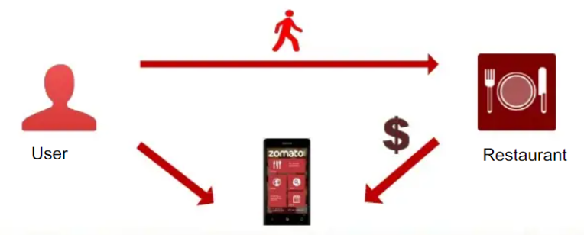
Introduction and Objectives :
Zomato, which started as Foodiebay, was established in July 2008 by two IIT Delhi alumnus, Deepinder Goyal, and Pankaj Chaddah.
Operates in 16 countries including India, UAE, UK, Brazil, Canada, Australia, Turkey, Poland and New Zealand.
However, with on paper companies, Zomato's presence has crossed to over 40 countries in the world.
Mission :
The team is looking for expansion and opening new restaurants.
Helping people discover great places around them
Building amazing experiences around dining
Understanding market trends.

Slide 3
Data Overview :
Restaurant ID: Unique identifier for each restaurant.
Restaurant Name: The name of the restaurant.
CountryCode: Country code of the location where the restaurant is situated.
Country:Total 16 countrys is fetch from given sheet.
City: The city where the restaurant is located.
Address: The specific address of the restaurant.
Locality: The locality or neighborhood where the restaurant is situated.
Locality Verbose: Detailed information about the locality.
Longitude: The geographical longitude coordinate of the restaurant.
Latitude: The geographical latitude coordinate of the restaurant.
Cuisines: The type of cuisine offered by the restaurant. 9 missing value is deleted by me.
Currency: The currency used for transactions in the restaurant.
Has_Table_booking: Indicates whether the restaurant has a table booking option (Yes/No).
Has_Online_delivery: Indicates whether the restaurant offers online delivery (Yes/No).
Is_delivering_now: Indicates whether the restaurant is currently delivering (Yes/No).
Switch_to_order_menu: Indicates whether users can switch to the order menu (Yes/No).
Price_range: A numeric value indicating the price range category of the restaurant.
Votes: The number of votes or ratings/(feedback) received by the restaurant.
Average_Cost_for_two: The average cost for two people dining at the restaurant.Convert in INR all.
Rating: The overall rating of the restaurant is based on user reviews.
Datekey_opening: The date when the restaurant was opened.Year is displaced from date.

Slide 4
Data Cleaning:
Data Cleaning : Utilized functions like FIND,REPLACE and
Remove Duplicate to ensure data accuracy.
Acquiring Data : Enhanced the dataset with additional variables using VLOOKUP
to cross- reference external data sources.
Descriptive Analysis: Employed Pivot Tables for the key metrics and identifying
sales pattern across different regions and product categories.
Filtering data: Applied SORT and FILTER functions to classify customer based
on purchasing behavior and demographics.
Visualization: Created dynamic charts and dashboards of data representation
enabling interactive data exploration.
Extracting the imp column
Cleaning the data
Formatting the table
Apply filtering

Slide 5
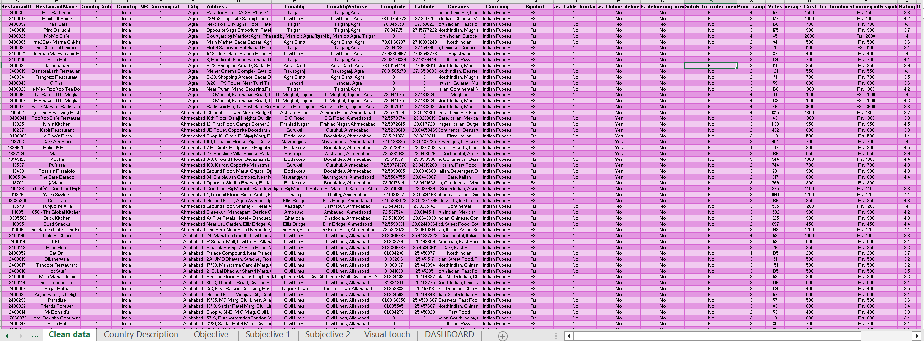
Raw data

Slide 6
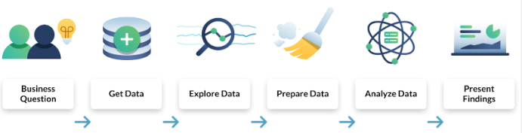
Methodology :
Analytical methods and tools used:
Using VLOOKUP to get country name with the help of country code given in 2nd sheet
Vlookup and formating is used to get INR value of avg of two cost column.
In Cuisines data set Handling missing values either by deleting or entering values.
Applying Text function with “yyyy” intake to get year specific.
Many visualization technique is applying to get proper charts and slicers.
In this country is present so I used specifically map visualization in dashboarding.

Slide 7
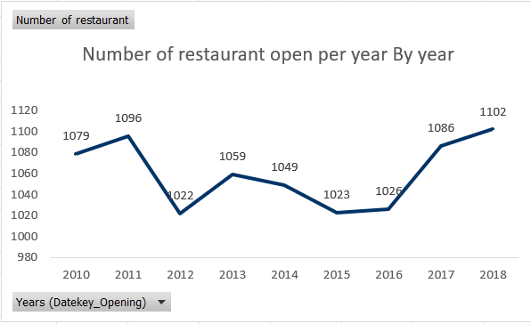
Analysis of Objective Questions :
The graph shows Year wise Opened Restaurant in the Zomato analytics data.
A non-linear graph indicate that the number of restaurant open is increases drastically.

Slide 8
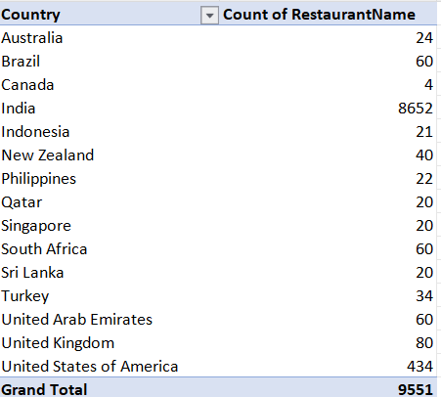
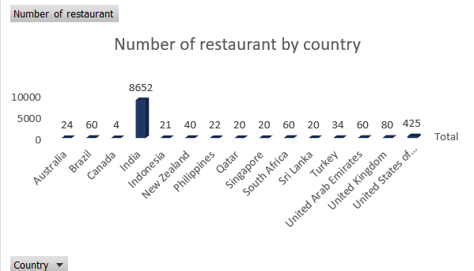
Number of restaurant present in each country
In this india has greatest number of restaurant with highest population density.
And Canada, Indonesia, Qatar, Turkey has bottom most amount of restaurant .
.

Slide 9
Average Rating of all country suggest that a good cuisines affect the country .
Rating is count by customer priortised restaurants as well as good quality of food either by online booking or delivery option available.
Indonesia has the highest average number of votes at 772, followed by United Arab Emirates at 494
Brazil, Singapore has the lowest average votes.

Slide 10
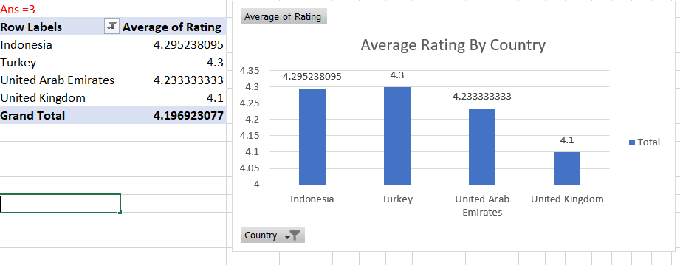
Country selection for opening new restaurant
I m selecting this four country because of their good average rate of interest.
We may be select more country but four is enough to analyse the Zomato to open new restaurants.

Slide 11
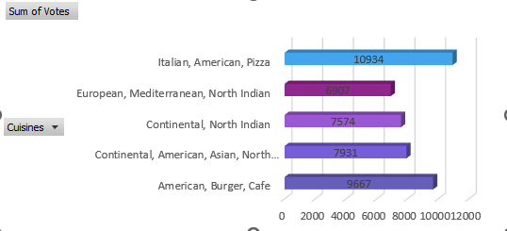
Cuisines plays a major role in the famous restaurants
M Voting technique : Analyzing cuisine popularity can help me determine if a particular cuisine aligns with our sum of voting strategy. Popular cuisines might allow you to set highest votes and attract a larger customer base.

Slide 12
Recommendations for opening new restaurants
Target those area where no. of restaurant is less :
Analyze areas with a low density of existing restaurants but high overall ratings. This suggests a market with
customer demanding areas .
Target Price Range of the Restaurants :
Analyze the price range most frequented by audience. Align your restaurant's concept and
pricing strategy with their budget preferences to maximize appeal
Price Range Correlation with Cuisine:
Identify any correlations between price range and cuisine
Exploring Existing High-Rated Restaurants :
Identifying the high rated restaurant for knowing which cuisine make audience attract.
Prioritize Budget-Friendly Options in Cost-Conscious Areas:
Analyze data to identify areas with a lower average cost for two

Slide 13
More Recommendations
Exploring Rating Correlation with Cuisine: Identifying the rating of cuisine that has great rated in different restaurant of country
Delivery Penetration Rate: Calculate the percentage of restaurants offering online delivery in country. A high penetration rate suggests a strong customer preference for delivery options.
Correlation with Cuisine:
Analyze if specific cuisines are more likely to offer online delivery. This might indicate higher customer
demand for delivery for those cuisine types.
Delivery Popularity by Area:
Identify areas with a high concentration of restaurants offering delivery. This suggests a strong customer base
for delivery services, potentially driven by factors like busy lifestyles or limited dine-in options.

Slide 14
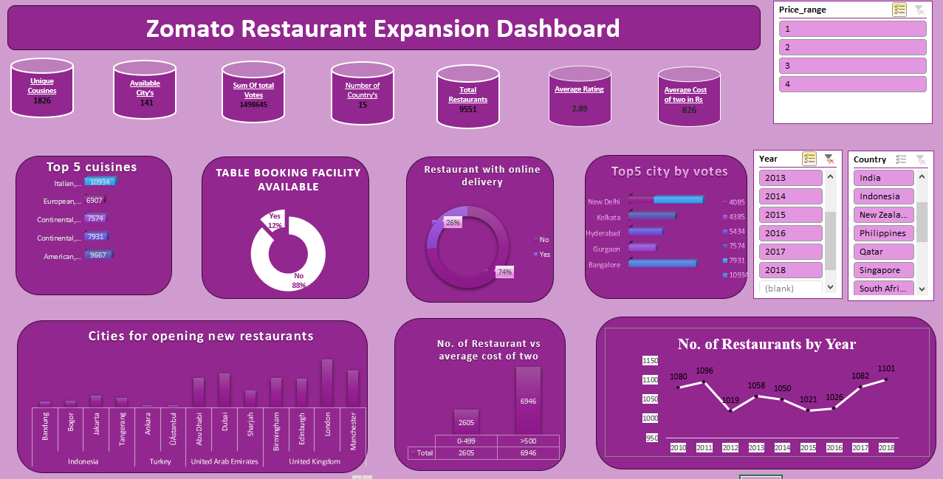
Dashboard and Visualizations :

Slide 15
Insights
Raw Data analysis has revealed valuable insights to guide Zomato's strategic selection of a new restaurant location in the given country.
By Understanding Zomato data and market research, we can make informed decisions to maximize the success of Zomato new restaurant Opening in different cities.
This data analysis equips Zomato with a comprehensive understanding of trends and customer preferences, paying the way for a strategic restaurant launch according to many factors like votes, rating etc.
By prioritizing less saturated locations, Zomato's new restaurant can establish a strong presence and attract a Daily customer preference and easy to find in this technical world.
Aligning the restaurant concept with popular cuisine preferences will ensure strong customer appeal for Zomato's new venture

Slide 16
Conclusion :
In conclusion, after a thorough market analysis, Indonesia, Turkey, UAE and UK emerge as the final four countries that align with our selection criteria.
These countries exhibit a favorable combination of factors, including a lower number of restaurants, indicating a less saturated market, and an economic average cost for two.
The strategic prioritization of these markets positions us for a competitive edge, and the analysis lays the groundwork for focused and informed decision-making in our market expansion efforts.
Stakeholders are advised to align their investments with specific cuisines based on the desired investment range.
For those with lower investment capabilities, investing in Cafe shops proves to be a strategic choice. On the other hand, stakeholders with higher investment capacities are encouraged to consider Native or Italian cuisine restaurants.
This approach to cuisine selection ensures that investments are tailored to the financial capacities and strategic goals of the stakeholders, maximizing the potential for success in the chosen markets.

Slide 17
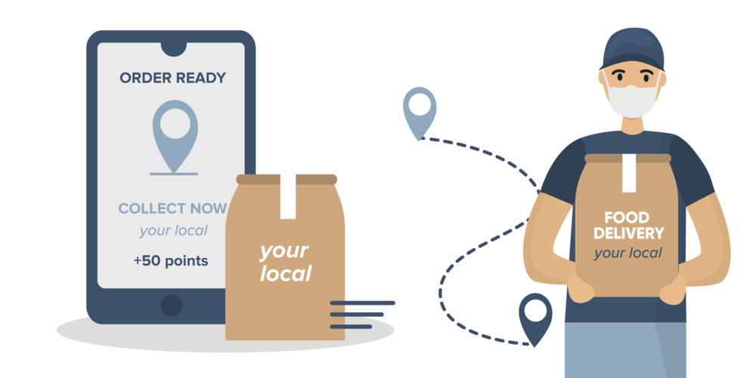


Reference
Zomato Application software
Search engines like
Data driven software

Slide 18
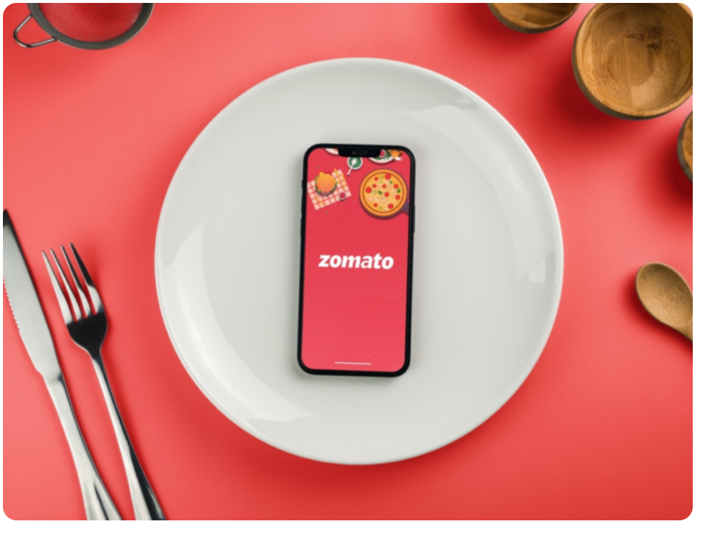
Acknowledgements: I express my heartfelt thanks and acknowledgment to Rishabh Verma, Vicky Pandey, Gyan Arora, Geetika Saha and Sourabh Jain for their exceptional guidance and significant support throughout the project.
Thank You

